Slide 1




ML Summit Workshop Day 3
By
Shatadru Majumdar
and
Purbayan Chowdhury

Slide 2
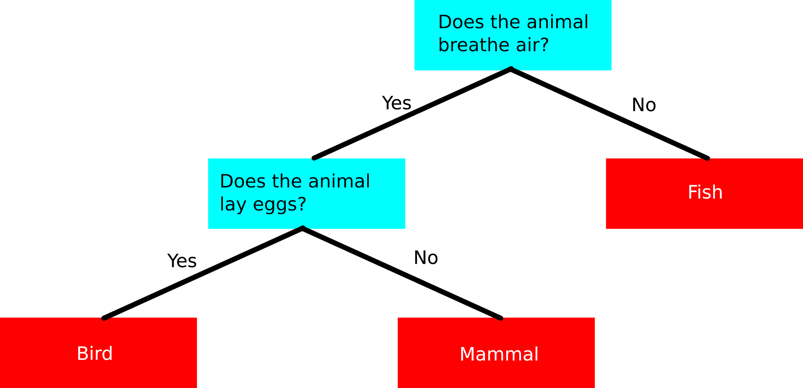
What is a Decision Tree?
Predictive Model in tree form that maps items to its target value, starting from root to leaf is known as a Decision Tree.
Types of Decision Tree:
Classification Tree
Regression Tree

Slide 3
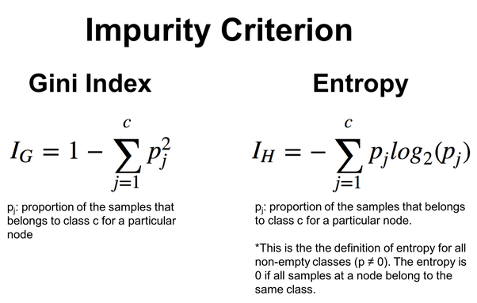
Entropy & Gini
Metrics for above mentioned algorithm can be:
Gini Impurity(GI): Measure of how a randomly chosen element is incorrectly labelled if it was randomly labelled according to its subset distribution.
Information Entropy(IE): Number of bits required in encoding the given data.
GI
IE

Slide 4
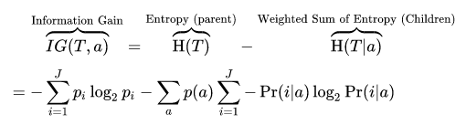
Information Gain
Information Gain is used to decide which features to split at each step while building the tree.
Our objective is to keep the tree as small as possible, thus we choose the split that results in the purest daughter nodes.
The information value represents the expected amount of information that would be needed to specify whether a new instance should be classified yes or no, given that the example reached that node.

Slide 5
How does it work?
Look on the blackboard

Slide 6
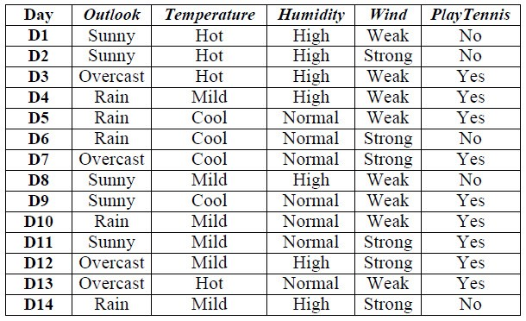
Case Study
Let’s consider the example where our objective is to figure out whether we should go out to play Tennis or not.

Slide 7
Case Study
First we determine the information gain for each candidate attribute(i.e, Outlook, Temperature, Humidity and Wind) and then select the one with highest information gain.
Attribute Outlook:
Outlook_Rain = {2+, 3-}
Outlook_Sunny = {3+, 2-}
Outlook_Overcast = {4+, 0-}
Gain(S,Outlook) = Entropy(S) — 5/14 Entropy(S_Outlook_Rain) — 5/14 Entropy(S_Outlook_Sunny) — 4/14 Entropy(S_Outlook_Overcast)
Gain(S,Outlook) = 0.246

Slide 8
Case Study
First we determine the information gain for each candidate attribute(i.e, Outlook, Temperature, Humidity and Wind) and then select the one with highest information gain.
Attribute Temperature:
Temperature_Hot = {2+, 2-}
Temperature_Mild = {4+, 2-}
Temperature_Cool = {3+, 1-}
Gain(S,Temperature) = Entropy(S) — 4/14 Entropy(S_Temperature_Hot) — 6/14 Entropy(S_Temperature_Mild) — 4/14 Entropy(S_Temperature_Cool)
Gain(S,Temperature) = 0.029

Slide 9
Case Study
Similarly, the information gain for all the attributes are as follows :
Gain(S,Outlook) = 0.246
Gain(S,Temperature) = 0.029
Gain(S,Wind) = 0.048
Gain(S,Humidity) = 0.151
According to the information gain measure, the Outlook attribute provides the best prediction of the target attribute, PlayTennis, over the training examples. Therefore, Outlook is selected as the decision attribute for the root node, and branches are created below the root for each of its possible values (i.e., Sunny, Overcast, and Rain).

Slide 10
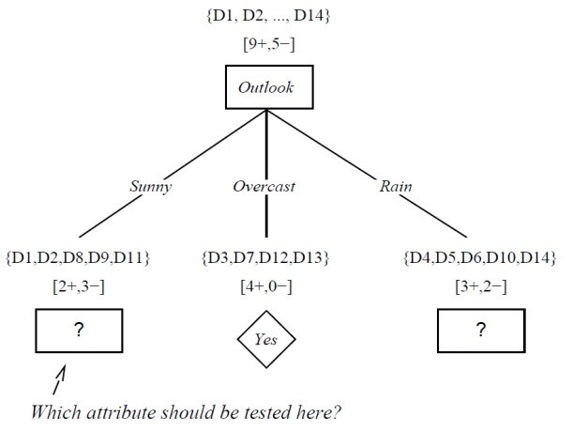
Case Study
The resulting partial decision tree is shown in Figure, along with the training examples sorted to each new descendant node.

Slide 11
Case Study
-> Note that every example for which Outlook = Overcast is also a positive example of PlayTennis. Therefore, this node of the tree becomes a leaf node with the classification PlayTennis = Yes. In contrast, the descendants corresponding to Outlook = Sunny and Outlook = Rain still have non-zero entropy, and the decision tree will be further elaborated below these nodes.
-> The process of selecting a new attribute and partitioning the training examples is now repeated for each non terminal descendant node, this time using only the training examples associated with that node.
-> Attributes that have been incorporated higher in the tree are excluded, so that any given attribute can appear at most once along any path through the tree. This process continues for each new leaf node until either of two conditions is met: (1) every attribute has already been included along this path through the tree, or (2) the training examples associated with this leaf node all have the same target attribute value (i.e., their entropy is zero).

Slide 12
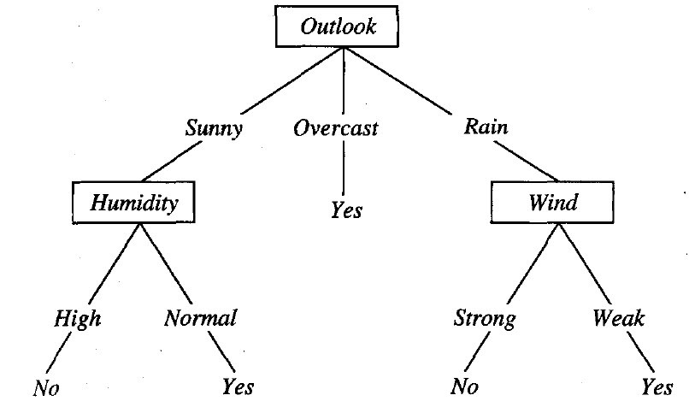
Case Study
Eventually, our Final decision tree turns out to be like this:

Slide 13
Notebook

Slide 14
What are Support Vector Machines?
Support Vector Machines construct a hyperplane or set of hyperplanes in a high or infinite-dimensional space, which can be used for classification, regression, or other tasks like outliers detection.
An SVM model represents examples as points in space, mapped in such a way that the examples of the separate categories are divided by a clear gap as wide as possible.
In addition to performing linear classification, SVMs can efficiently perform a non-linear classification using what is called the kernel trick, implicitly mapping their inputs into high-dimensional feature spaces.

Slide 15
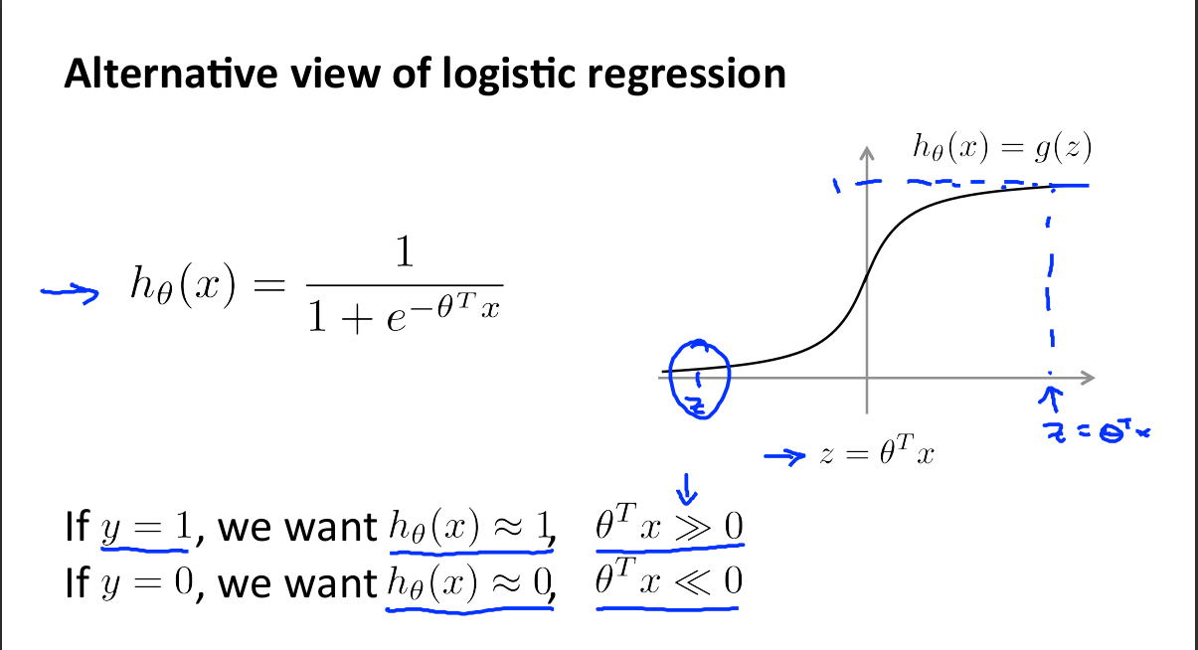

Slide 16
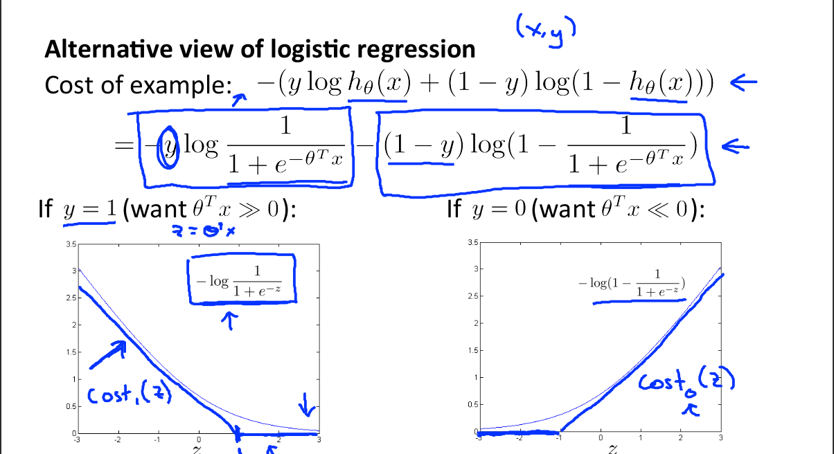

Slide 17
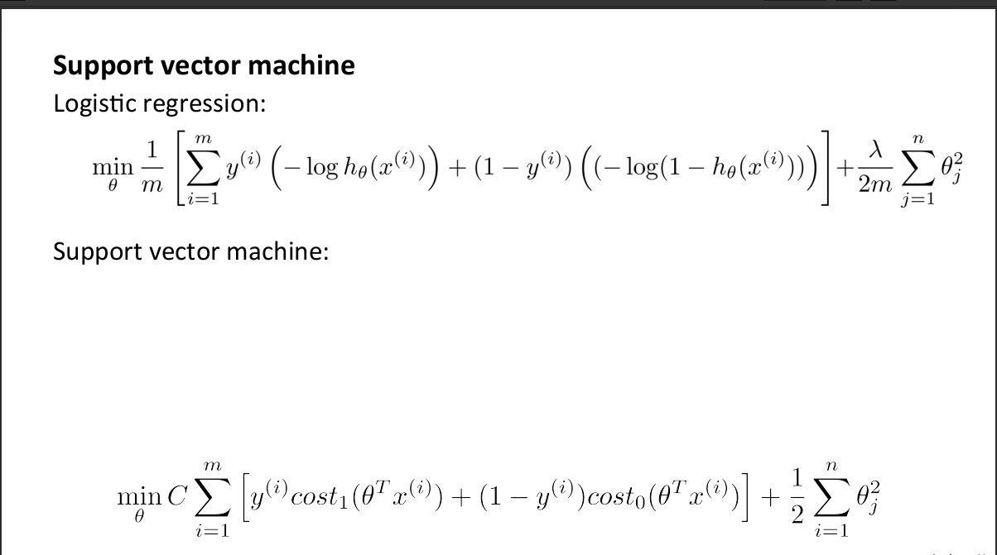

Slide 18
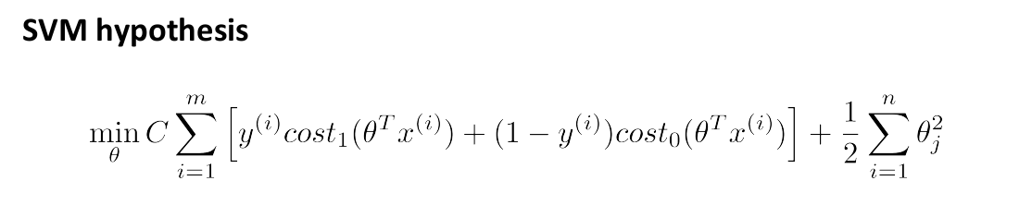

Slide 19
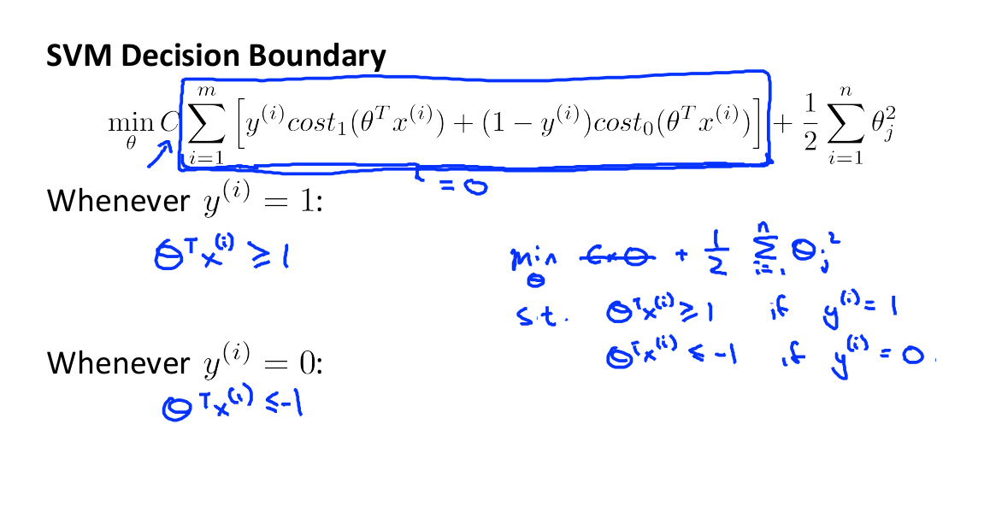

Slide 20
Hard Margin
If the training data is linearly separable, we can select two parallel hyperplanes that separate the two classes of data, so that the distance between them is as large as possible. The region bounded by these two hyperplanes is called the "margin", and the maximum-margin hyperplane is the hyperplane that lies halfway between them.

Slide 21
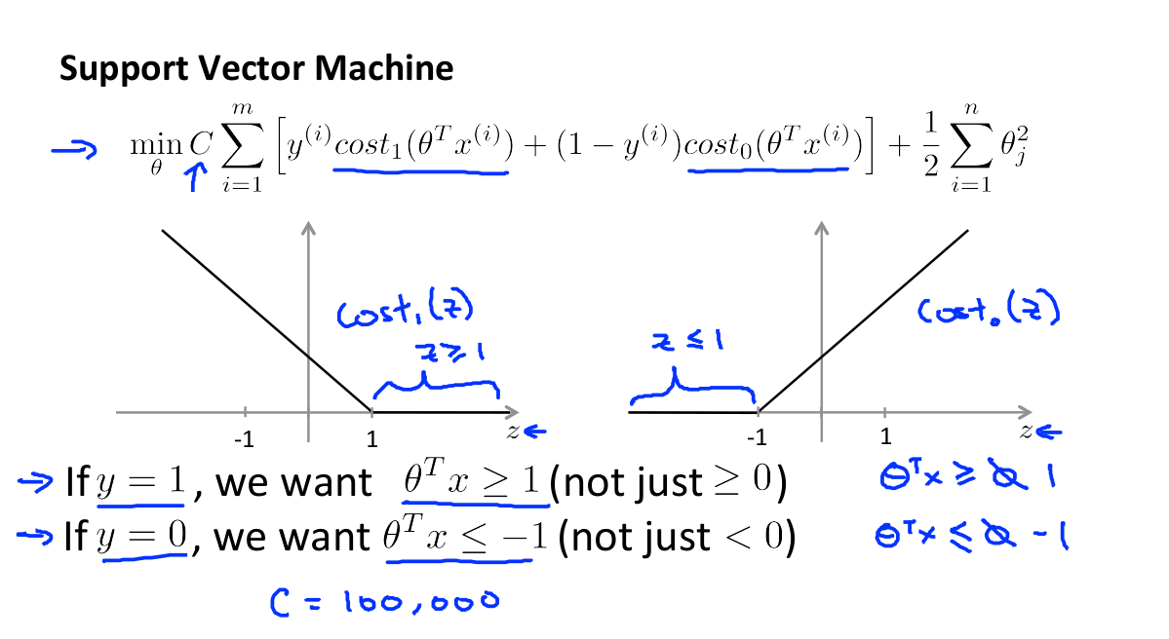

Slide 22
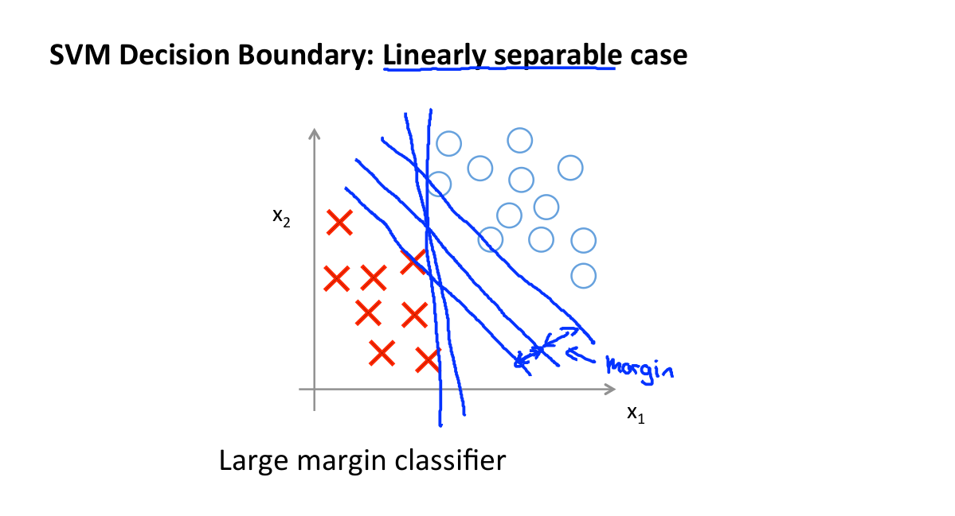

Slide 23
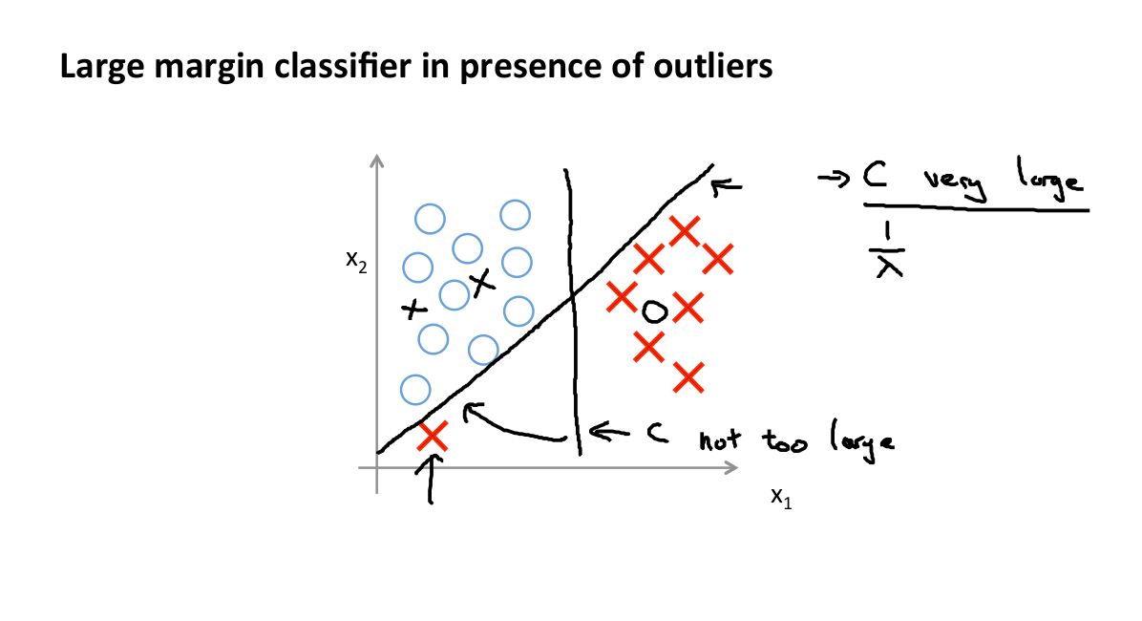

Slide 24
Soft Margin
To extend SVM to cases in which the data are not linearly separable, we introduce the hinge loss function,
y_{i} is the i-th target and is the current output.
This function is zero if the constraint in (1) is satisfied, in other words, if vector x_{i} lies on the correct side of the margin.
For data on the wrong side of the margin, the function's value is proportional to the distance from the margin.

Slide 25
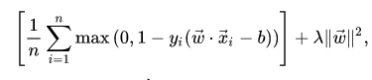
Soft Margin
We then wish to minimise:
where the parameter λ determines the trade-off between increasing the margin size and ensuring that vector x_{i} lie on the correct side of the margin. Thus, for sufficiently small values of λ, the second term in the loss function will become negligible, hence, it will behave similar to the hard-margin SVM, if the input data is linearly classifiable.

Slide 26
Decision Boundary

Slide 27
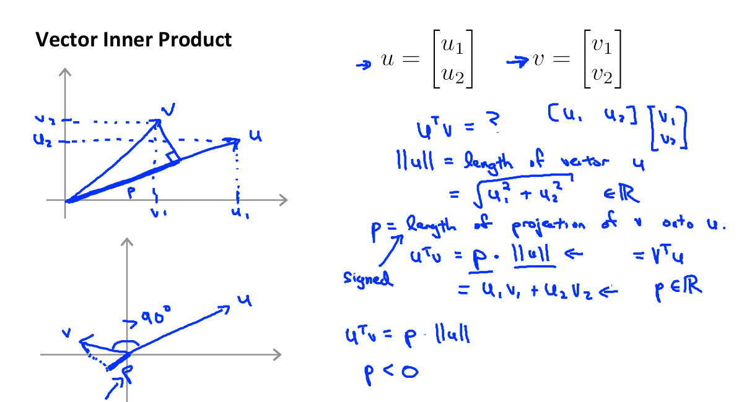

Slide 28
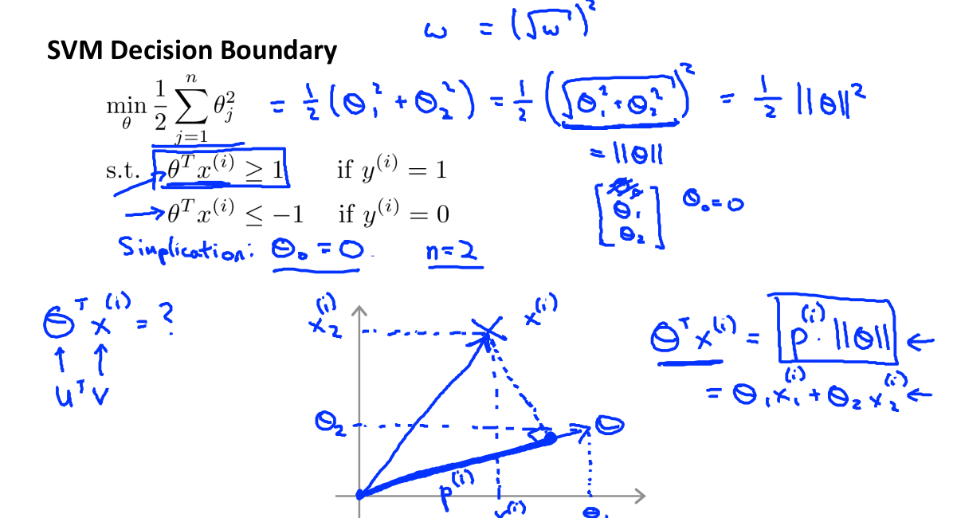

Slide 29
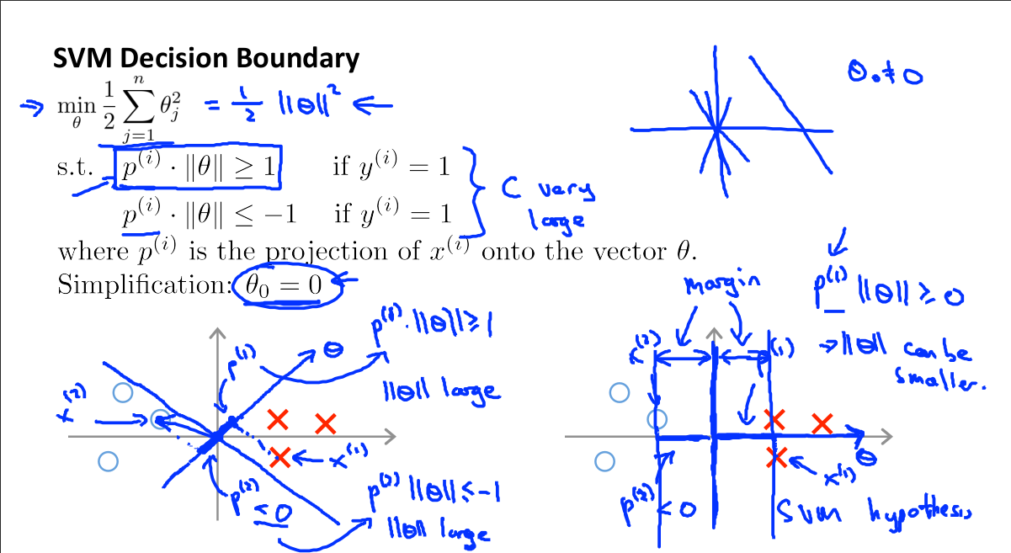

Slide 30
Kernels

Slide 31
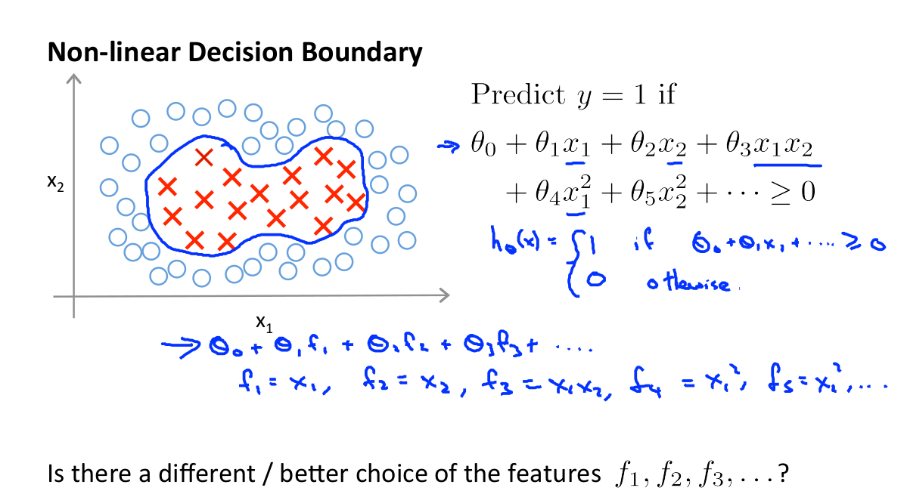

Slide 32
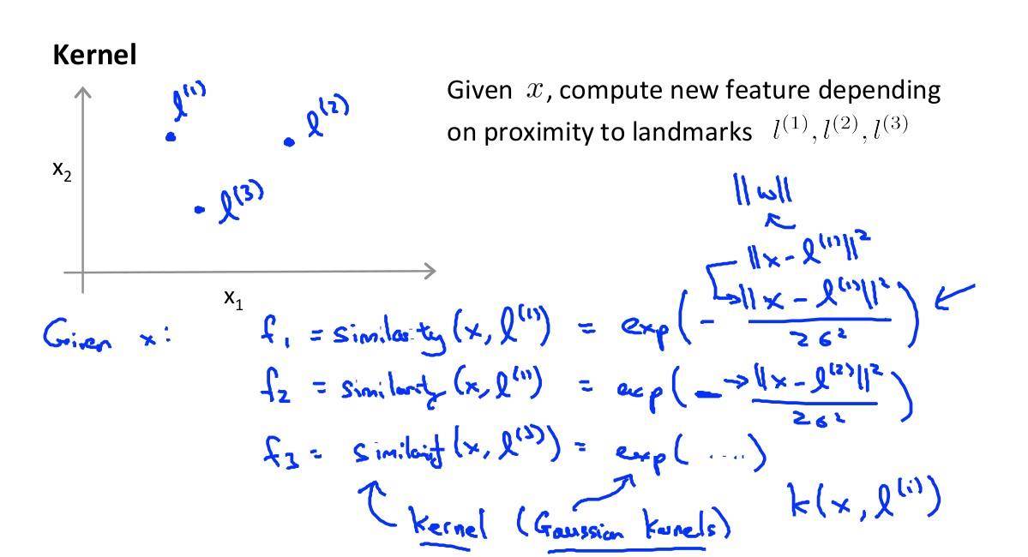

Slide 33
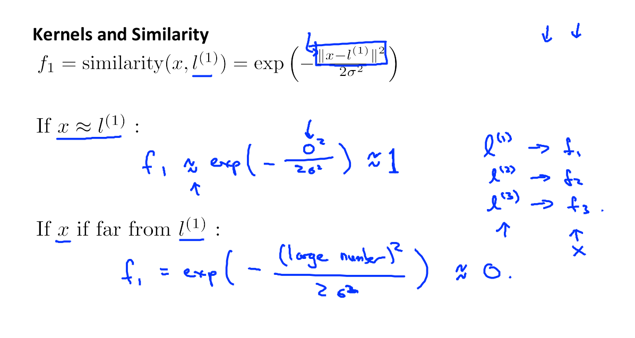

Slide 34
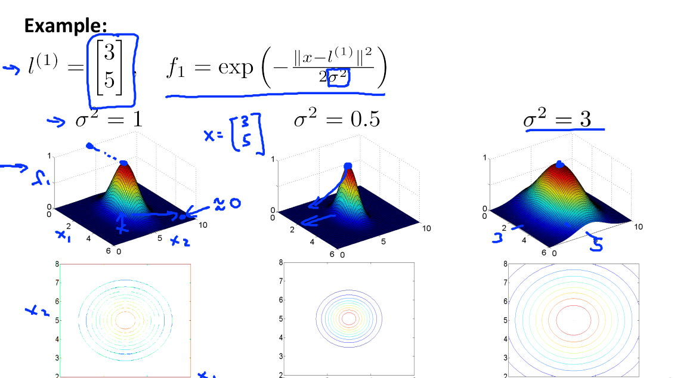

Slide 35
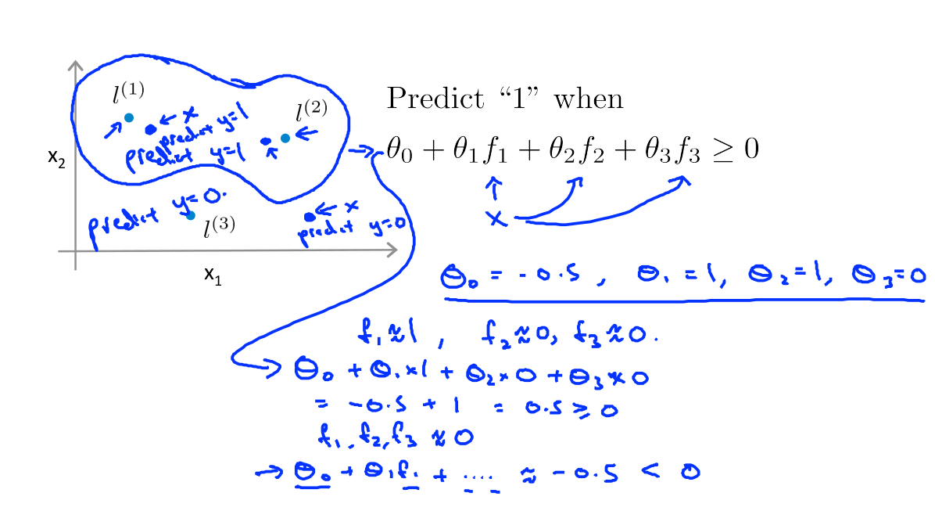

Slide 36
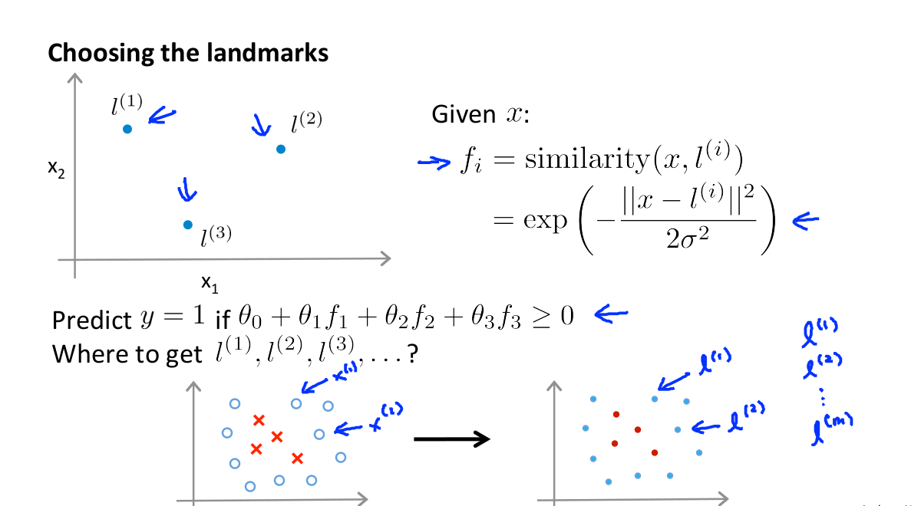

Slide 37
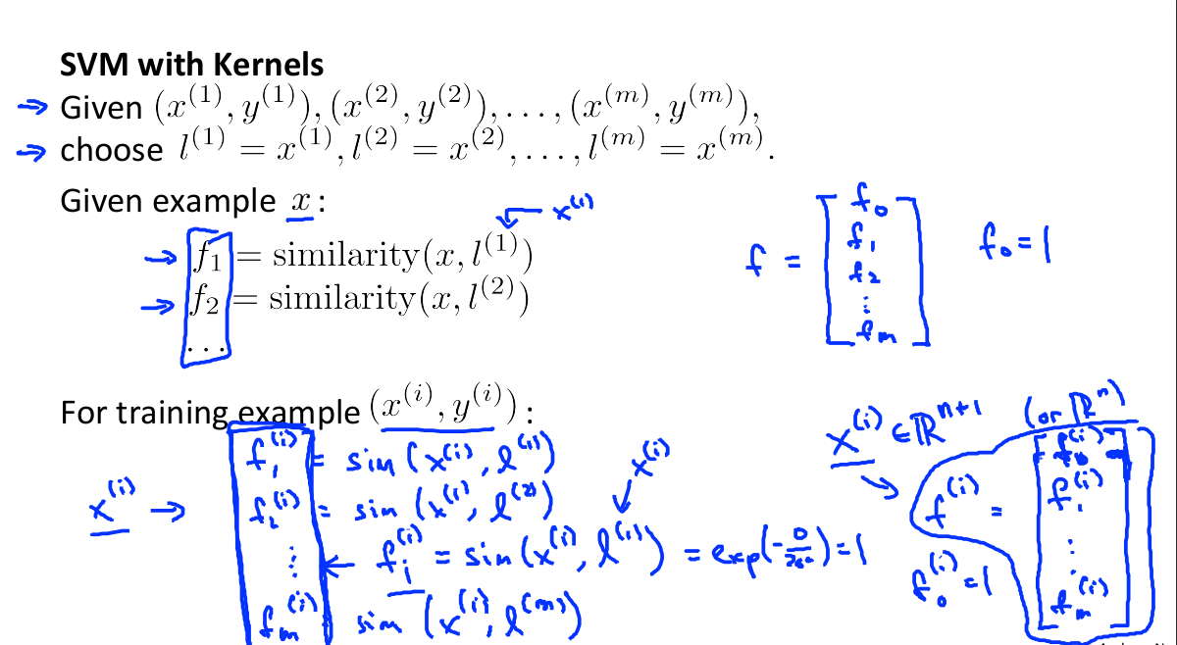

Slide 38
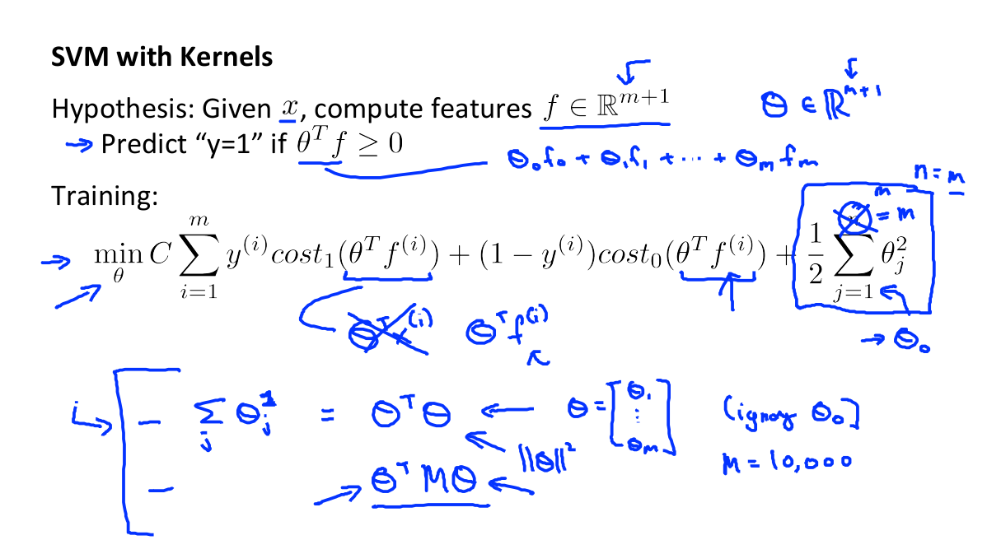

Slide 39
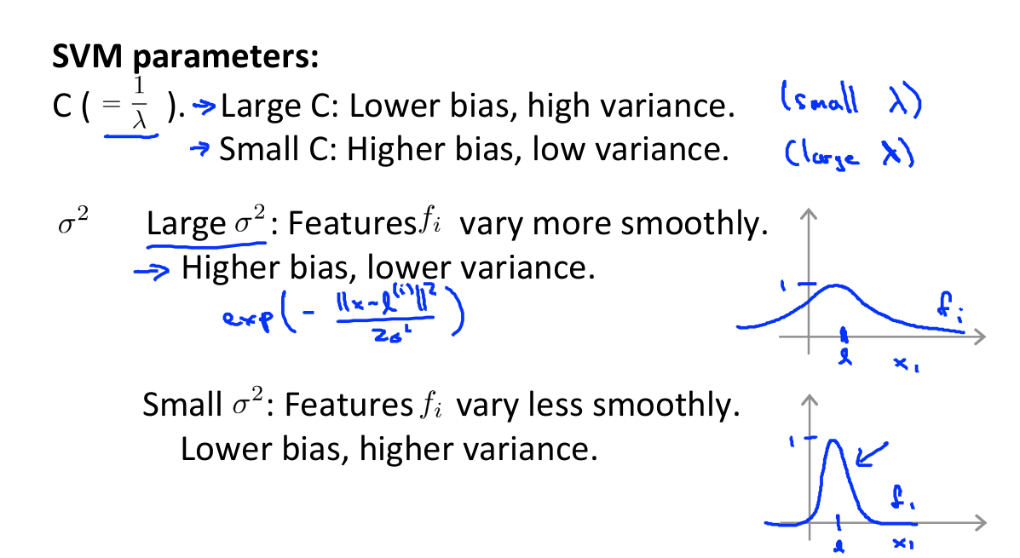

Slide 40
Logistic Regression vs. SVMs
Let us consider the following notation:
n = number of features, m = number of training examples
If n is large relative to m:
Use logistic regression, or SVM without a Kernel(“linear kernel”)
If n is small, m is intermediate:
Use SVM with Gaussian Kernel.
If n is small, m is large:
Create/add more features, then use logistic regression or SVM without a kernel

Slide 41

Presented by:
Shatadru Majumdar (https://github.com/shatadru99)
Purbayan Chowdhury (https://github.com/shivishbrahma)
Soham Biswas (https://github.com/Nibba2018)
Balaka Biswas (https://github.com/BALaka-18)
and
Team Explore ML and Team Innovacion

